Slide 1

Shanghai Car License Plate Auction Price Time Series
Matt Dunne, Qianyun (Iris) Lin, Glynis Myers, & Ruohan Zhou
8/23/2018

Slide 2
Agenda
Overview & Objective
Initial Analysis
Methodology
Accuracy Comparison
Cross Validation On Selected Model
Summary & Future Work

Slide 3


Overview
Description
Shanghai implemented an auction system to sell a limited number of license plates to fossil-fuel car owners each month to help tackle the pollution problem
Auction prices vary month by month since the government wants to regulate the total number of cars in Shanghai
An interesting dataset to work with as this is currently the most valuable piece of metal in Shanghai

Slide 4
Project Description
Objective
The purpose of this project is to forecast the following year and a half (19 months) of auction prices for the Shanghai car license plates with monthly data for total number of license plates issued, lowest price, average price, and number of applicants from January 2002 to July 2018 (a total of 198 records).
Further context
Only 19 months will be forecasted as the data is highly volatile and gets increasingly more restrictive as 2.8m people are competing for 6.5K plates (<0.3% of people competing) as of February 2018*.
Methodology
In order to find the best method for this dataset, the following models were explored to improve accuracy in forecasting average license plate price: Linear Regression, Auto.Arima, ETS, ARIMAX, and tsCV combined with one of the previous mentioned models.
*https://www.economist.com/china/2018/04/19/why-a-licence-plate-costs-more-than-a-car-in-shanghai
Notes:
The team will look at predicting the performance of total number of licenses issued utilizing and assessing the accuracy of several different models applying techniques learned in class. The final model will be selected based on accuracy.

Slide 5
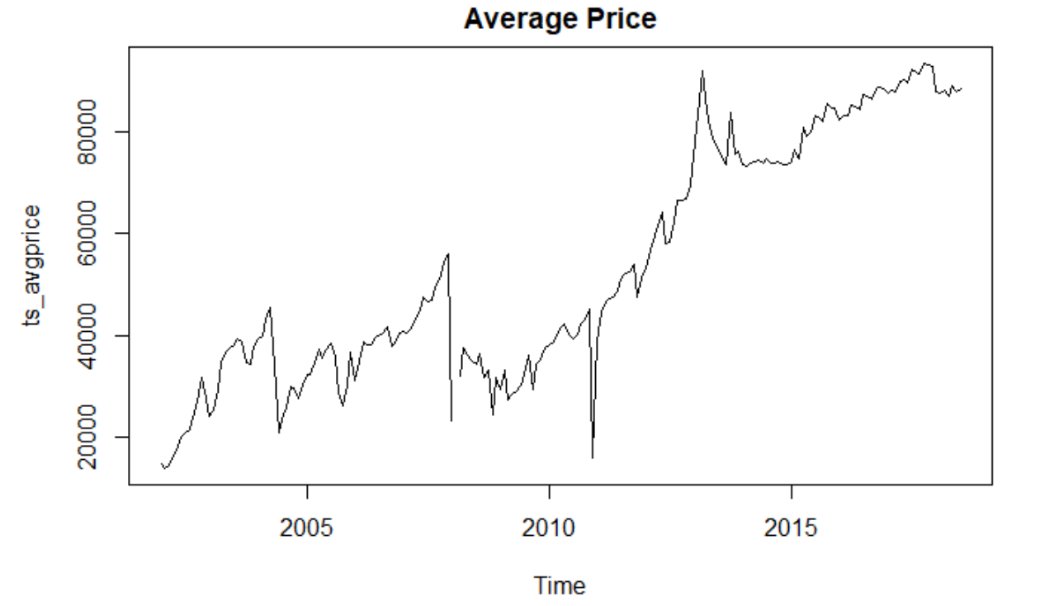
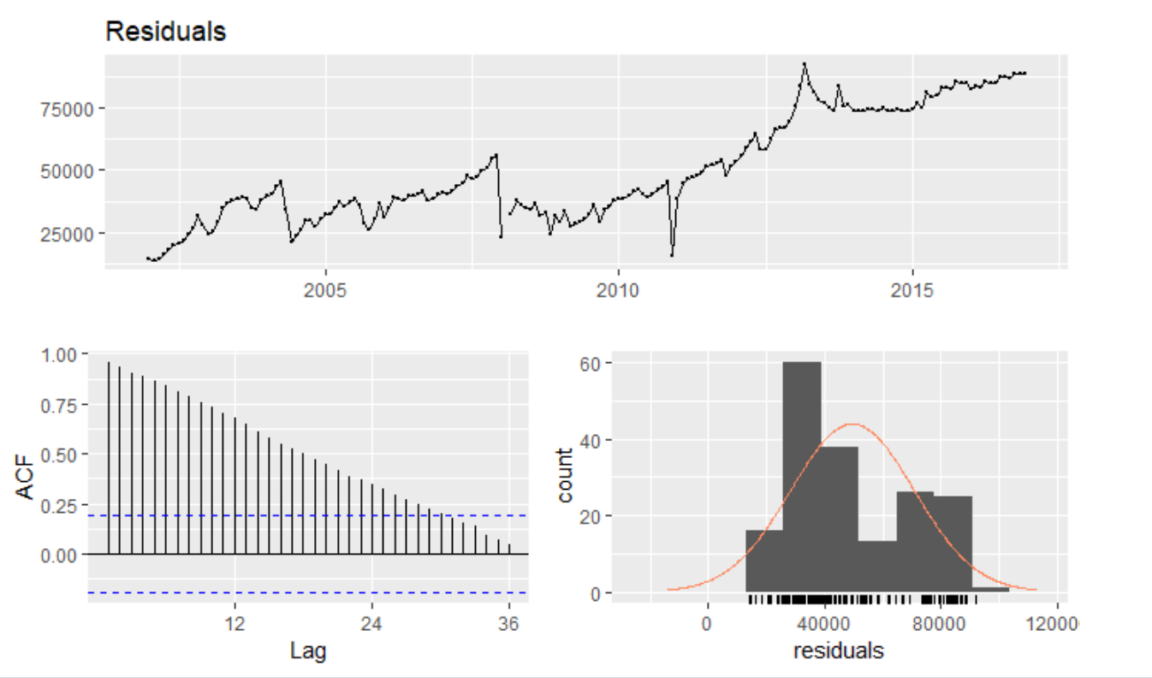
Initial Analysis/Data Cleaning
In order to understand the data better, and how the launch of the auction affected the average license plate price, the following information was cleaned and adjustments were made accordingly:
Four elements: Number of license issued, number of applicants, average price, lowest price.
The overall trajectory of the data is non-stationary, non-seasonality, and has an upward trend.
February 2008 data is missing likely due to data input errors and was amended with the previous average.
The data has strong autocorrelation, the residuals do not resemble white noise, and are not normally distributed validating the need for a robust forecasting method.

Slide 6
Results

Slide 7
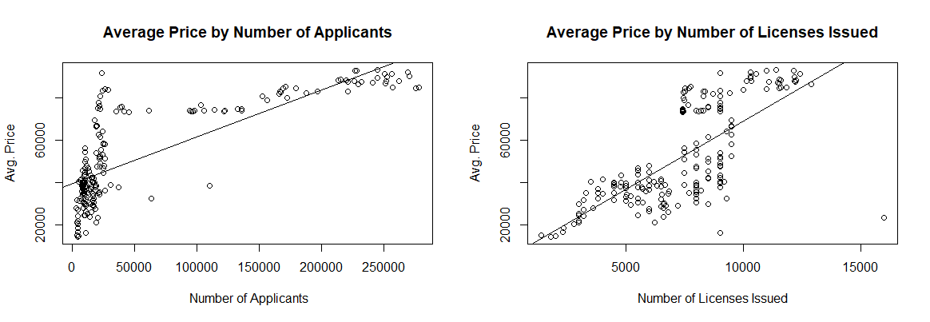
Linear Regression
Looking at Average Price against Applicants, Licenses shows a relationship
Relationship is not prediction and neither Applicants or Licenses do a particularly good job
even when you look at Applicants per License
even when you segment

Slide 8
Linear Regression - R Squared
Model | R² Using lm() | R² Using tslm()
Number of Applicants | 0.63 | 0.63
Number of Applicants (<30,000) | 0.40 | N/A
Number of Applicants (>30,000) | 0.54 | N/A
Number of Licenses Issued | 0.50 | 0.51
Number of Applicants + Licenses Issued | 0.71 | 0.71
Demand Ratio | Overall: 0.60 Low: 0.06 Medium: 0.16 High: 0.08 | 0.60

Slide 9
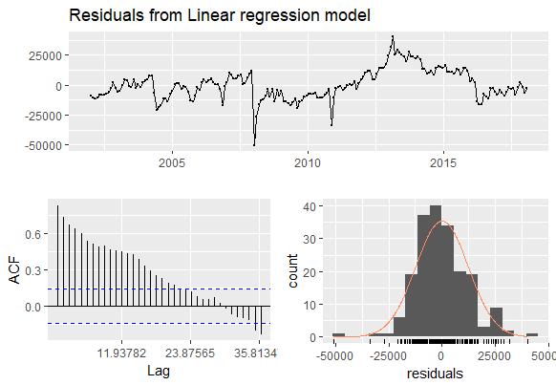
Linear Regression - Autocorrelation of Residuals
Breusch-Godfrey says autocorrelation of residuals

Slide 10
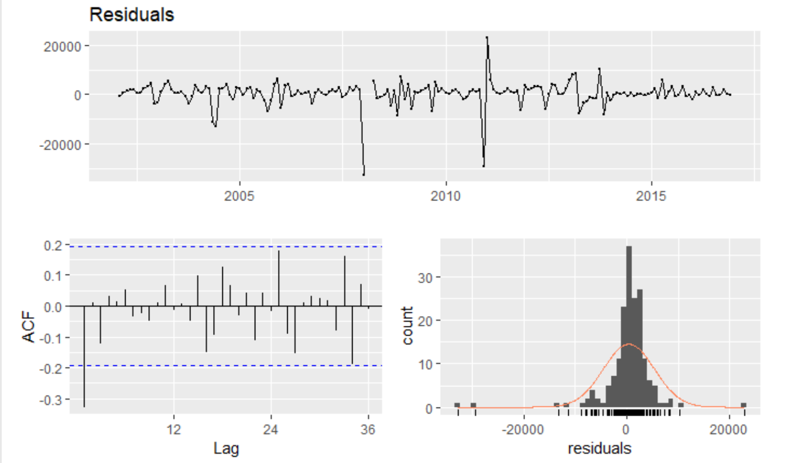
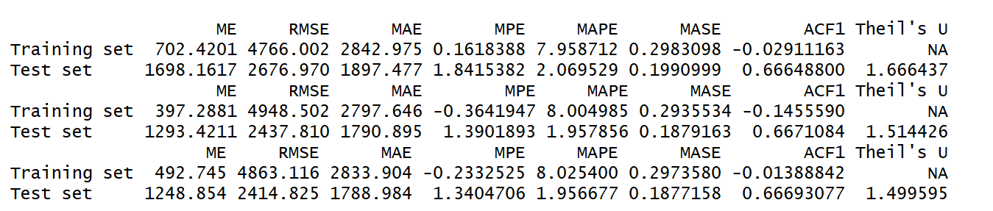
Auto.Arima & Arima
Train: January 2002 to December 2016
Test: January 2017 to July 2018
Auto.arima() function with different information criterion
AIC: Best model: ARIMA(1,1,3)
BIC:Best model: ARIMA(0,1,0)
AICc:Best model: ARIMA(1,1,3)
Pure auto.arima: ARIMA(1,1,0)
ARIMA (1,1,0) is the best model

Slide 11
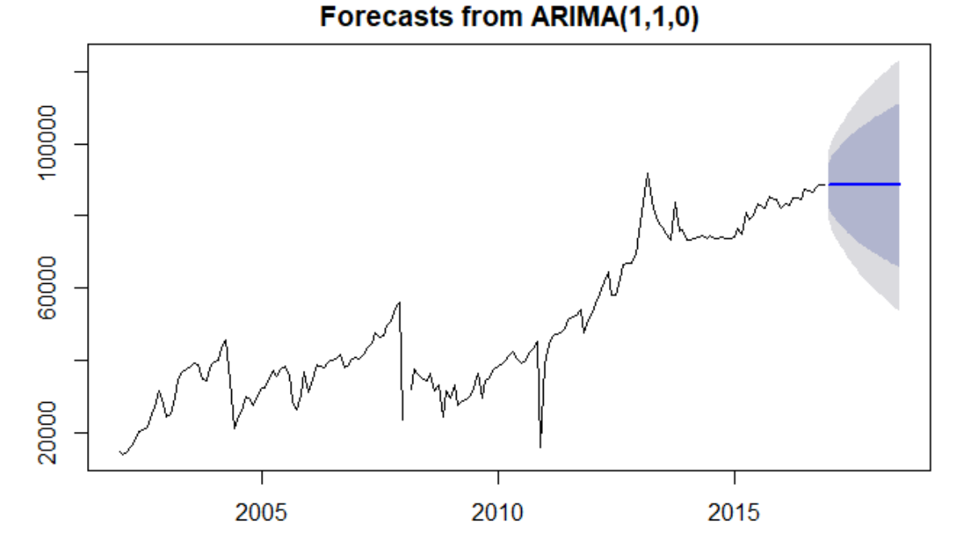
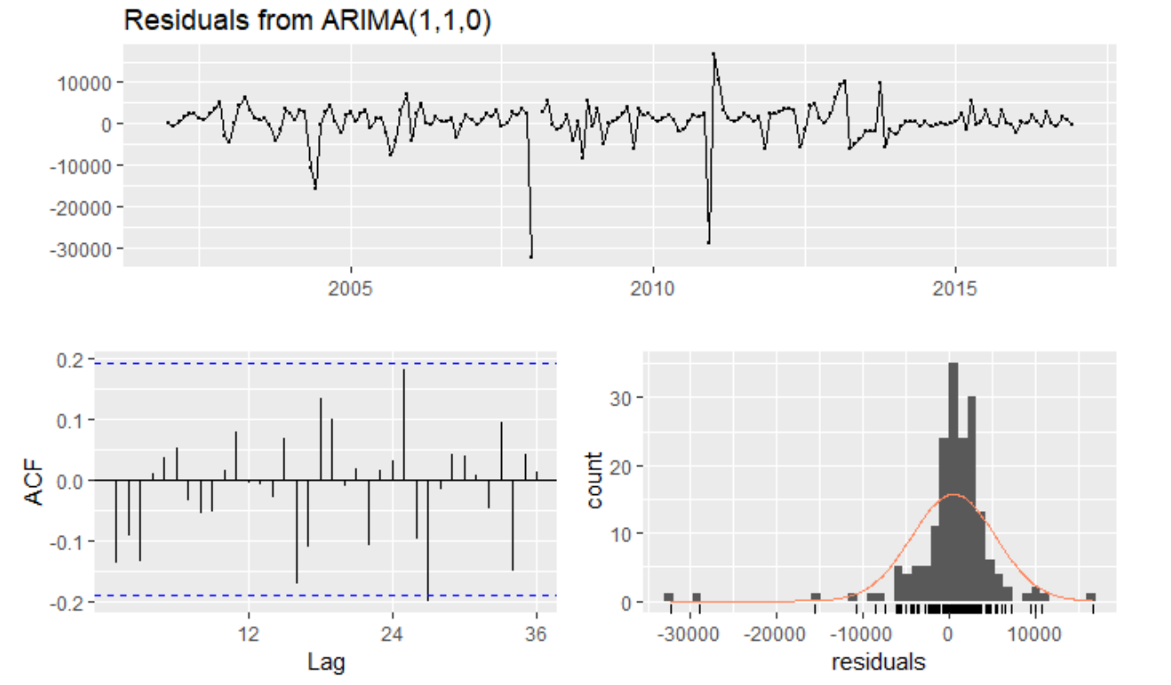
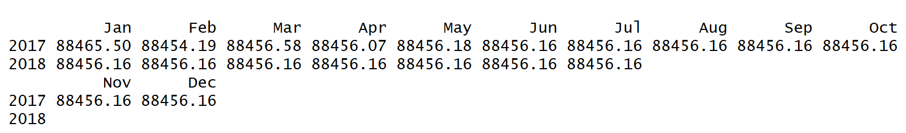
Auto.Arima & Arima

Slide 12
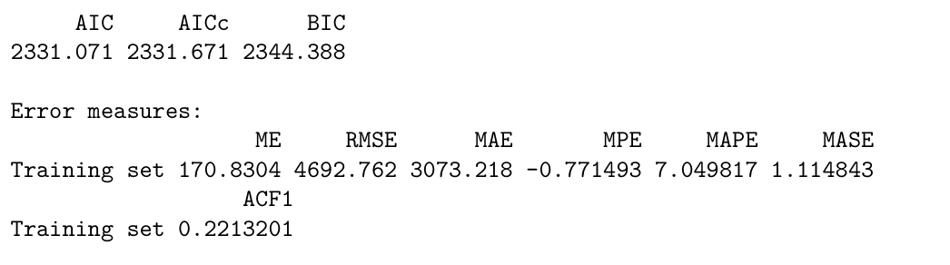
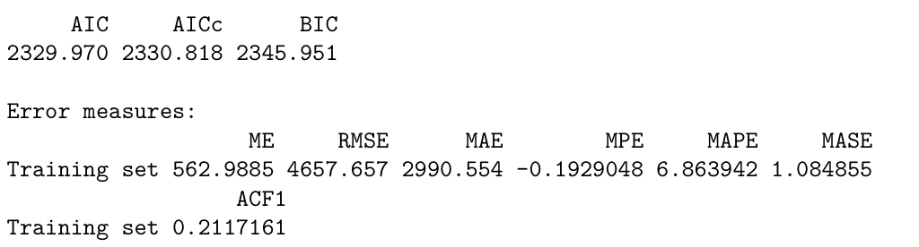
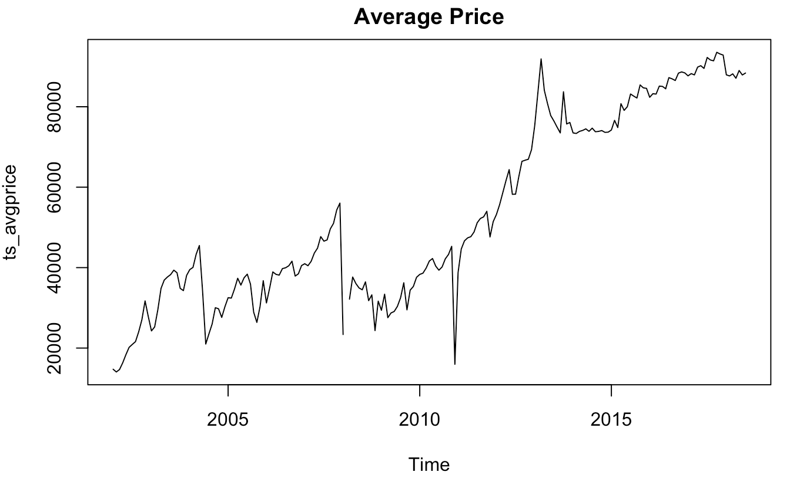
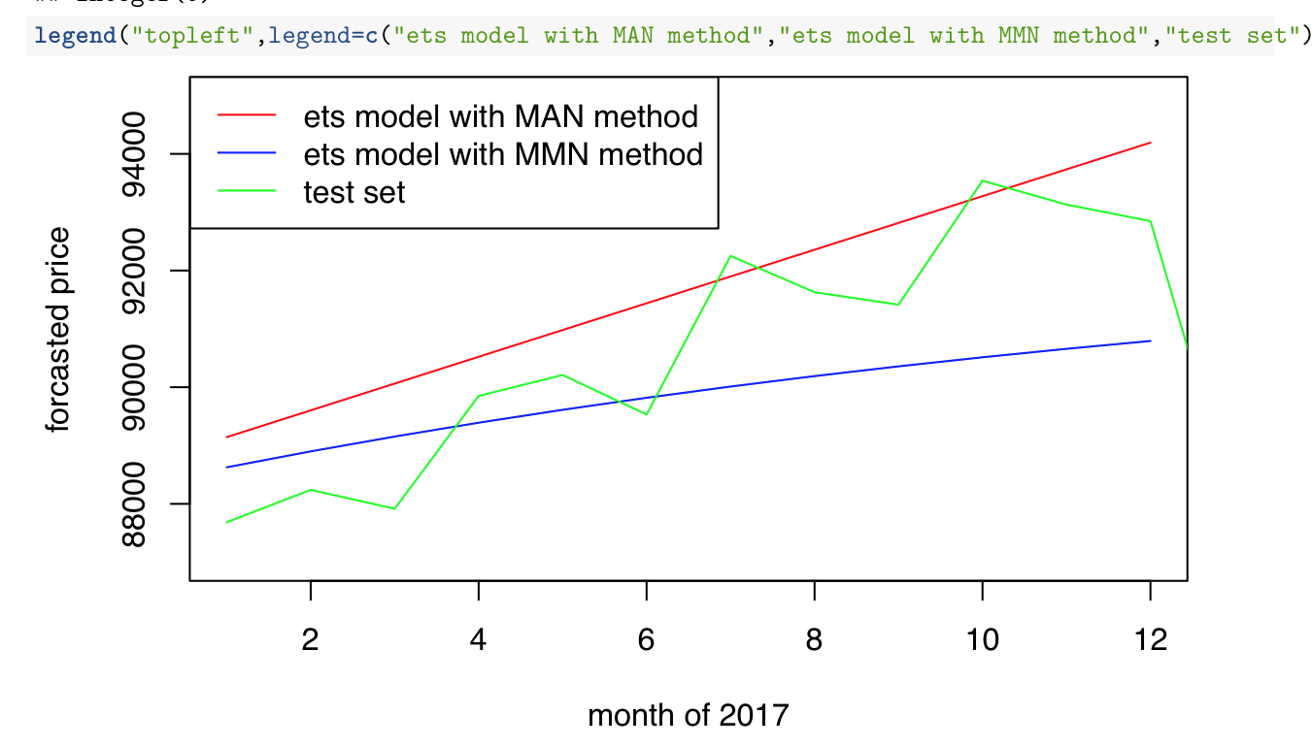
ETS - Time Series Plot
method 1
- multiplicative error, additive trend, non-seasonality
method 2
- multiplicative error, multiplicative trend, non-seasonality

Slide 13
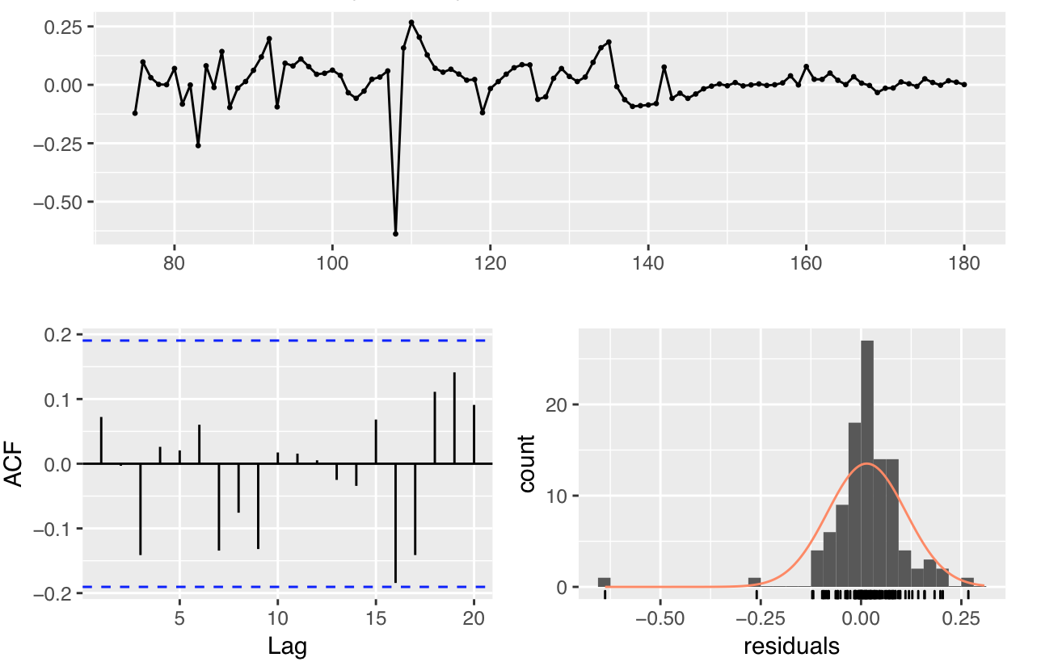
ETS - Autocorrelation of Residuals of MMN method
Notes:
residuals plot: stationary and no pattern
acf: mean of zero, nothing out of the boundary
histogram: normally distributed with some outliers at the left side
-> white noise

Slide 14
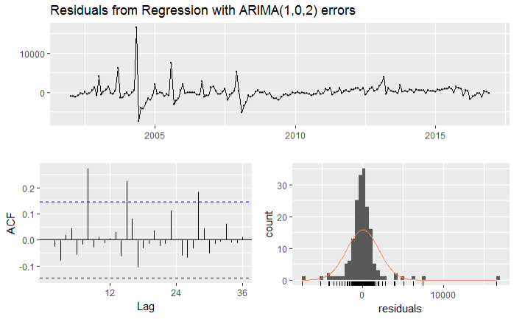
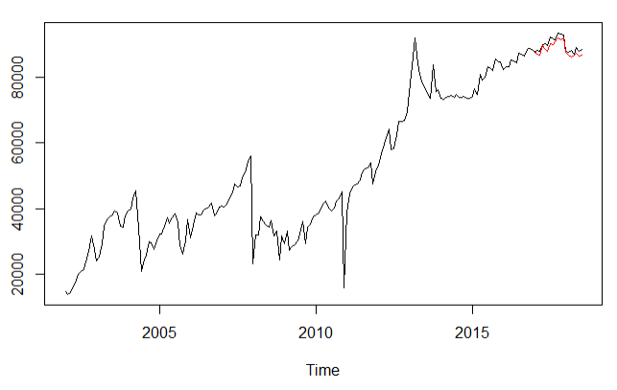
Arimax
Using the original Arima model detailed in previous slides and incorporating the significant regressor (“Total Number of Licenses Issued” & “Lowest Price”) we are able to fit a very close model with a very low MPE and the residuals do not appear to be autocorrelated. That being said, there are still a few outliers and the residuals appear to be leptokurtic potentially implying an overfit model.
Arimax Summary
Arimax Comparison

Slide 15
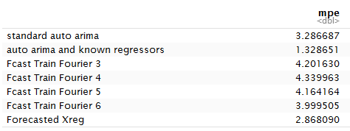
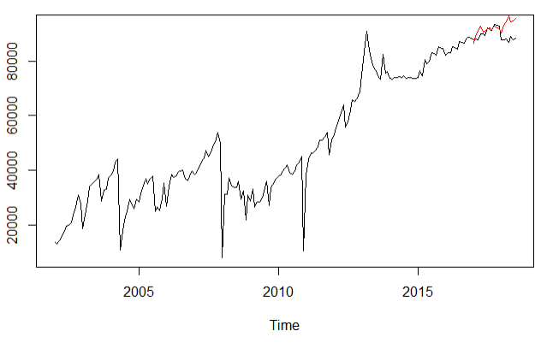
Arimax
Building off the previous slide, two extra approaches were taken as regressors will likely be unknown: using fourier transformation (k=3:6) in the extra regressors & forecasted each regressor based on the appropriate model for each.
The forecasted regressors resulted in the second lowest MPE but it had similar residuals (i.e. leptokurtic) to the auto.arima with known regressors, and the forecast had difficulty forecasting 2018. Because of this, other options were explored in the following section.
MPE Comparison
Forecasted Regressors
Notes:
k = 3:6 (no more than half that season)
K = 6 resulted in the lowest AICc for both total number of license issued and lowest price
Across all models, 2018 was the hardest to forecast

Slide 16
Model Comparison & Selection

Slide 17
Model Selection
While ETS and Arimax performed the best in terms of accuracy for forecasting average license plate cost, the Arima model was selected as the model for further exploration with tsCV. This is because the MPE was still relatively low, not overfitted, and Arima tends to handled non-seasonal and non-stationary data better.
Further expansion into tsCV analysis detailed on the following slide.
Accuracy Comparison
Arima model from Previous Section
 | Linear Regression | Arima | ETS with MAN | ETS with MMN | Arimax with forecasted regressors
MAE | 10,249.34 | 1,788.98 | 3,073.22 | 2,990.55 | 1,047.859
MPE | -15.27 | 1.34 | -0.77 | -0.19 | -0.41

Slide 18
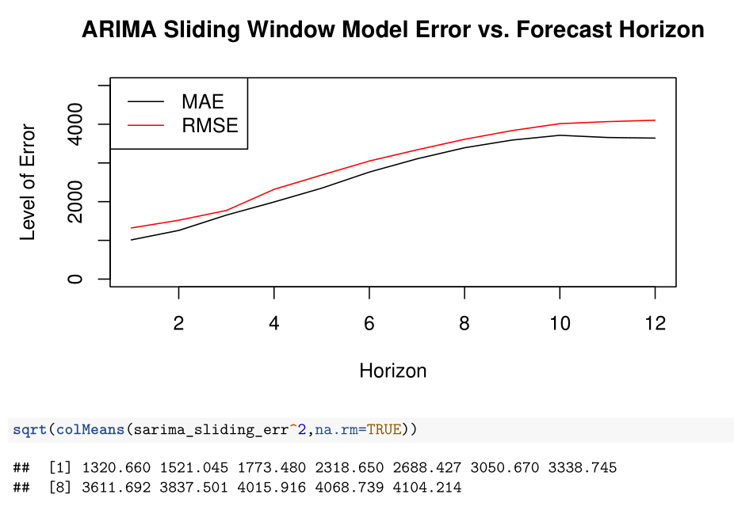
tsCV

Slide 19
Accuracy Comparison
Adding in tsCV we can see that MAE and MPE is further improved validating the importance of including a model like this into analysis and forecasting.
 | Linear Regression | Arima | ETS with MAN | ETS with MMN | Arimax with forecasted regressors | tsCV sliding with Arima
MAE | 10,249.34 | 1,788.98 | 3,073.22 | 2,990.55 | 1,047.859 | 1257.62 (2 month) 3393.57 (8 month)
MPE | -15.27 | 1.34 | -0.77 | -0.19 | -0.41 | -1.07 (2 month) -3.26 (8 month)
tsCV improves MAE, MPE for short time horizons

Slide 20
Conclusion

Slide 21
Summary
In summary, the average price for the Shanghai License Plate auction is an incredibly volatile number to forecast and several future improvements should be implemented in order to improve the model and be able to potentially forecast longer periods of time
Future Improvements
Further qualitative research
As it is clear that the auction is affected by a variety of things beyond the data available, gaining insight into what the customers really think and pressure they feel may give further understandings into supply and demand.
Expansion into other datasets
Building off the previous point, as the Shanghai License Plate auction is a direct result of the pollution problem in Shanghai, including other datasets into the model will likely improve forecast accuracy. Examples of these datasets are as follows: number of cars being sold in Shanghai, pollution indicator records in Shanghai, number of electric car sales in Shanghai, etc.
Have an ongoing forecast updated regularly
As was seen with the shift in price from 2017 to 2018, it is incredibly difficult to account for this sudden drop. Implementing an ongoing forecast updated as data is collected on a monthly, quarterly, or biannual will help mitigate this and help potential customers manage expectations and budgets.

Slide 22
Thank You!

